Slide 1

NAEPC &
The NAEPC Education Foundation
50th Annual Conference
COUNCIL LEADERSHIP DAY

Slide 2
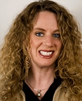
Welcome & Opening Remarks
Joanna Averett, CFP®, AIF®, AEP®

Slide 3


The Star Spangled Banner Lyrics
By Francis Scott Key, 1814
Oh, say can you see by the dawn's early light
What so proudly we hailed at the twilight's last gleaming?
Whose broad stripes and bright stars thru the perilous fight,
O'er the ramparts we watched were so gallantly streaming?
And the rocket's red glare, the bombs bursting in air,
Gave proof through the night that our flag was still there.
Oh, say does that star-spangled banner yet wave
O'er the land of the free and the home of the brave?
Oh! thus be it ever, when freemen shall stand
Between their loved home and the war's desolation!
Blest with victory and peace, may the heav'n rescued land
Praise the Power that hath made and preserved us a nation.
Then conquer we must, when our cause it is just,
And this be our motto: "In God is our trust."
And the star-spangled banner in triumph shall wave
O'er the land of the free and the home of the brave!

Slide 4
116 Councils Represented
Atlanta Estate Planning Council
Baltimore Estate Planning Council
Bergen County Estate Planning Council
Birmingham Estate Planning Council
Bluegrass Estate Planning Council
Boise Estate Planning Council
Boston Estate Planning Council
Boulder County Estate Planning Council
Central Arizona Estate Planning Council
Central Florida Estate Planning Council
Central Pennsylvania Estate Planning Council
Central Texas Estate Planning Council
Charlotte Estate Planning Council
Chester County Estate Planning Council
Chicago Estate Planning Council
Cincinnati Estate Planning Council
Coeur d'Alene Estate Planning Council
Colorado West Estate Planning Council
Conejo Valley Estate Planning Council
Dallas Estate Planning Council
Delaware Estate Planning Council
Denver Estate Planning Council
Desert Estate Planning Council
Estate & Business Planning Council of Hartford Connecticut
East Coast Estate Planning Council
Eastern Idaho Estate Planning Council
Eastern Illinois Estate Planning Council
Estate Planning Council of Berks County
Estate Planning Council of Central New York
Estate Planning Council of Chattanooga
Estate Planning Council of Cleveland
Estate Planning Council of Colorado Springs
Estate Planning Council of Diablo Valley
Estate Planning Council of Eastern New York
Estate Planning Council of Essex County
Estate Planning Council of Greater Miami
Estate Planning Council of Hampden County
Estate Planning Council of Memphis
Estate Planning Council of Naples
Estate Planning Council of New York City
Estate Planning Council of North Texas
Estate Planning Council of Northeast Florida
Estate Planning Council of Northern Nevada
Estate Planning Council of Portland
Estate Planning Council of Rhode Island
Estate Planning Council of San Bernardino
Estate Planning Council of San Diego
Estate Planning Council of Seattle
Estate Planning Council of Southeast Denver
Estate Planning Council of St. Louis
Estate Planning Council of Suffolk County
Estate Planning Council of the Lehigh Valley
Estate Planning Council of Westchester County
Estate Planning & Trust Council of Long Beach

Slide 5
116 Councils Represented
Eugene Estate Planning Council
Financial & Estate Planning Council of Metro Detroit, Inc.
Fresno Estate Planning Council
Greater Boca Raton Estate Planning Council
Greater Middlesex/Somerset Estate Planning Council
Greensboro Estate Planning Council
Greenville Estate Planning Council
Hampton Roads Estate Planning Council
Hawaii Estate Planning Council
Houston Business & Estate Planning Council
Houston Estate & Financial Forum
Hudson Valley Estate Planning Council
Lower Fairfield County Estate Planning Council
Martin County Estate Planning Council
Merrimack Valley Estate Planning Council
Mid-Iowa Estate & Financial Planners
Mid-Missouri Estate Planning Council
Milwaukee Estate Planning Forum, Inc.
Mississippi Estate Planning Council
Montgomery Estate Planning Council
Nassau County Estate Planning Council
New Hampshire Estate Planning Council
New Orleans Estate Planning Council
North Central Florida Estate Planning Council
North Central West Virginia Estate Planning Council
North Coast Estate Planning Council
Northern Virginia Estate Planning Council
Northshore Estate Planning Council
Northwest Washington Estate Planning Council
Omaha Estate Planning Council
Orange County Estate Planning Council
Philadelphia Estate Planning Council
Pinellas County Estate Planning Council
Pittsburgh Estate Planning Council
Pomona Valley Estate Planning Council
Quad City Estate Planning Council
Red River Valley Estate Planning Council
Redwood Empire Estate Planning Council
Riverside Estate Planning Council
Salt Lake City Estate Planning Council
San Antonio Estate Planning Council
San Francisco Estate Planning Council
Santa Clara County Estate Planning Council
Sioux Falls Estate Planning Council
Siouxland Estate Planning Council, Inc.
Southern Arizona Estate Planning Council
Southern Nevada Estate Planning Council
Spokane Estate Planning Council
Stanislaus County Estate Planning Council
Stockton Estate Planning Council
Suncoast Estate Planning Council
Tax & Estate Planning Council of Shreveport
Tampa Bay Estate Planning Council
Toledo Estate Planning Council
Tri-Cities Estate Planning Council
Tulsa Estate Planning Forum
Tuscaloosa Estate Planning Council
Upper Ohio Valley Estate Planning Council
Washington DC Estate Planning Council
Western Michigan Estate Planning Council
York County Estate Planning Council

Slide 6
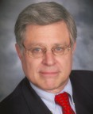
In Memoriam
NAEPC President-Elect

Slide 7
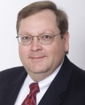
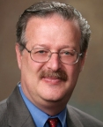
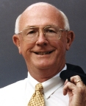
2013 Executive Committee
President
Joanna Averett, MBA, CFP®, AIF®, AEP®
First American Trust • San Bernardino, CA
Treasurer
Gregory E. Sellers, CPA, AEP®
Warren Averett, LLC • Montgomery, AL
Secretary
Jordon N. Rosen, CPA, MS (taxation), AEP®
Belfint, Lyons & Shuman, CPAs • Wilmington, DE
Immediate Past President
Clark B. McCleary, CLU®, ChFC®, MSFS, AEP® (Distinguished)
McCleary & Associates • Houston, TX

Slide 8
2013 Board of Directors
S. Mark Alton, CFP®, ChFC®, CLU®, CAP®, AEP®, MSFS, CPWA®
The Armory Group at Morgan Stanley Wealth Management • Syracuse, NY
Director Emeritus: Hartman Axley, CLU®, ChFC®, JD, CFP®, MSFS, RHU, AEP®
Lakewood, CO
Thomas M. Borchert, CLU®, ChFC®, AEP®, CLTC
Professional Insurance & Financial Alternatives • Sioux City, IA
Julie A. Buschman, CPA, AEP®
Bessemer Trust Company, N.A. • Dallas, TX
M. Eileen Dougherty, CTFA, CFP®, AEP®, ChFC®
Hawthorn - PNC Family Wealth • Philadelphia, PA
Charles V. Douglas, JD, CFP®, AEP®
Wells Fargo Private Bank • Atlanta, GA
John P. Garniewski, Jr., CPA/PFS, CFP®, AEP®
Wilmington Family Office • Wilmington, DE

Slide 9
2013 Board of Directors
Pettus C. Gibbons, MEd, CLU®, ChFC®, LUTCF, AEP®
New York Life Insurance Company • Addison, TX
Robert P. Goodman, CPA, AEP®, CFP®
U.S. Trust, Bank of America Private Wealth Management • Phoenix, AZ
Christopher P. Jakyma, JD, CTFA, AEP®
First Merit Wealth Management Services • Medina, OH
Al W. King, III, JD, LL.M., AEP® (Distinguished)
South Dakota Trust Company, LLC • New York, NY
William D. Kirchick, Esq., AEP®
Bingham McCutchen LLP • Boston, MA
Lawrence M. Lehmann, JD, AEP®
Lehmann Norman & Marcus LC • New Orleans, LA
Paul J. Pantano, CLU®, ChFC®, AEP®, CASL, MSFS
The Luttner Financial Group, Ltd. • Pittsburgh, PA
Paul S. Viren, CLU®, ChFC®, AEP®
Viren and Associates, Inc. • Spokane, WA

Slide 10
Past Presidents in Attendance
Hartman Axley, CLU®, ChFC®, JD, CFP®, MSFS, RHU, AEP®
Lakewood, CO
Robert F. Baldwin, Jr., LL.B., AEP®
Baldwin & Sutphen, LLP • Syracuse, NY
Kathleen J. Belmonte, CTFA, AEP®
Sabal Trust Company • Tampa, FL
Herbert Chasman, JD, CLU®, ChFC®, AEP® (Distinguished)
Shuster Financial Group, LLC • Irvine, CA
Dan H. Florence, JD, AEP®, CTFA
Commercial Bank of Texas • Nacogdoches, TX
Gary L. Flotron, MBA, CLU®, ChFC®, AEP®
University of Missouri - St. Louis • St. Louis, MO
Thomas M. Forrest, TO, CPA, AEP® (Distinguished)
U.S. Trust Company of Delaware • Wilmington, DE
Henry Gissel, Jr., LL.B., AEP® (Distinguished)
Wilmington Trust Co. • Houston, TX
Michael W. Halloran, CLU®, ChFC®, AEP®, CFP®, REBC, RHU, LUTCF, MSFS, MSM
Northwestern Mutual • Jacksonville, FL
A. Stephen McDaniel, JD, AEP®, EPLS
Wyatt, Tarrant & Combs, LLP • Memphis, TN
Joanna Reiver, Atty, AEP®
Gawthrop & Greenwood, P.C. • Wilmington, DE
B. Michael Watkins, CPA/PFS, CLU®, ChFC®, CFP®
Oro Valley, AZ
Gerald A. Youngs, AEP®, CTFA
Clearwater, FL
Registered to attend as of 11/09/13

Slide 11
Non-Board Volunteers
Accredited Estate Planner® Designation Committee
M. Eileen Dougherty, CTFA, CFP®, AEP®, ChFC®, Chair
Christine S. Bell, CTFA, AEP®
Jacksonville, FL
Kathleen J. Belmonte, CTFA, AEP®
Tampa, FL
Gary L. Flotron, MBA, CLU®, ChFC®, AEP®
St. Louis, MO
Robert E. Fox, CLU®, AEP®
Ocala, FL
Theodore L. Greenspan, JD, LL.M., AEP®
Mobile, AL
John T. Midgett, JD, AEP®
Virginia Beach, VA
Colleen D. O'Connell, JD, AEP®
Bedford, NH
Daniel A. Rich, JD, MBA, TO, AEP®
Denver, CO
Lawrence A. Schwartz, CPA, MST, AEP®
Boston, MA
John C. Scott, CPA/ABV, AEP®
St. Louis, MO
Jeffrey M. Turner, CFP®, CLU®, ChFC®, MBA, AEP®
Chattanooga, TN
Eido M. Walny, Atty, EPLS, AEP®
Fox Point, WI

Slide 12
Non-Board Volunteers
Annual Conference Committee
Jordon N. Rosen, CPA, MS (taxation), AEP®, Chair
Kathleen J. Belmonte, CTFA, AEP®
Tampa, FL
William F. Denney, CLU®, AEP®
Newark, DE
Jerry Engel
Deborah Erdmann
Las Vegas, NV
Joseph V. Falanga, CPA, AEP®, TEP
New York, NY
Gary L. Flotron, MBA, CLU®, ChFC®, AEP®
St. Louis, MO
Michael W. Halloran, CLU®, ChFC®, AEP®, CFP®, REBC, RHU, LUTCF, MSFS, MSM
Jacksonville, FL
Lesley S. Hogan, JD, LL.M.
West Palm Beach, FL
Lawrence J. Macklin, JD, CPA, AEP®
Baltimore, MD
John K. O'Meara, JD, CLU®, ChFC®, CFP®, AEP®
Milwaukee, WI
Jason Oshins, MBA
Las Vegas, NV
Nancy H. Place, CFP®
Boston, MA
Richard A. Oshins, JD, LL.M., MBA, AEP® (Distinguished)
Las Vegas, NV
Neil Schoenblum, JD, LL.M.
Las Vegas, NV
Harold A. Schwartz, Jr., LL.B., LL.M. (taxation), CLU®, ChFC®, RHU,
REBC, FLMI, CEBS, AEP®
Chattanooga, TN
Kristen E. Simmons, JD
Las Vegas, NV
Robert C. Slane, CLU®, AEP®
Winter Park, FL

Slide 13
Non-Board Volunteers
Council Relations Committee
Paul S. Viren, CLU®, ChFC®, AEP®, Chair
Lawrence K. Bogar, AWMA, ChFC®, AAMS, LUTCF, AEP®
New York, NY
Richard G. Chalifoux, JD, AEP®
Garden City, NY
Robert E. Fox, CLU®, AEP®
Ocala, FL
Lawrence Fuller, CLU®, ChFC®, FLMI
Columbia, MO
Eric Charles Kordsmeier, CFP®, MBA, AEP®
Dallas, TX
Mary Katherine Mac Nee, CRPC®, CFP®
Riverside, CA
Laura Malone, CAP®
Hudson, OH
John J. Meyer, CLU®, ChFC®, AEP®
New Orleans, LA
Christine Anne Myers, CPA, MTax, AEP®
Cleveland, OH
Amy E. O'Bannon, CTFA, AEP®
Memphis, TN
James J. Ruggiero, Jr., JD, AEP®
Paoli, PA
Stephen F. Starzec, CPA, CTFA
Boulder, CO
Brent A. Thomas
New Orleans, LA
Richard E. Wait, CPA, CVA, AEP®
Reno, NV
Elaine Wait
Port Orange, FL
Eido M. Walny, Atty, EPLS, AEP®
Fox Point, WI

Slide 14
Non-Board Volunteers
Publications Committee
Charles V. Douglas, JD, CFP®, AEP®, Chair
Joseph V. Falanga, CPA, AEP®, TEP
New York, NY
Sharon Goodman, JD, AEP®
New York, NY
Susan P. Rounds, JD, CPA, LL.M. (taxation), AEP®
Atlanta, GA
Thomas D. Seck, JD, LL.M. (taxation), AEP®
Costa Mesa, CA
Martin M. Shenmkan, CPA, PFS, MBA, JD, AEP® (Distinguished)
Tenafly, NJ
Website & Technology Committee
Robert P. Goodman, CPA, AEP®, CFP®, Chair
Dan H. Florence, JD, AEP®, CTFA
Nacogdoches, TX
Laura Malone, CAP®
Hudson, OH

Slide 15

Retiring Board Member
Clark B. McCleary

Slide 16
Election
Three Appointments, Board Term Expiring December 2014
Susan P. Rounds, JD, CPA, LL.M. (taxation), AEP®
Wells Fargo • Atlanta, GA
Category: Attorney
Paul J. Pantano, CLU®, ChFC®, AEP®, CASL, MSFS
The Luttner Financial Group, Ltd. • Pittsburgh, PA
Category: CFP®, ChFC®, AEP®
John C. Scott, CPA/ABV, AEP®
Anders Minkler Huber & Helm LLP • St. Louis, MO
Category: CPA

Slide 17
Election
Board Term Expiring December 2016
William D. Kirchick, Esq., AEP®
Bingham McCutchen LLP • Boston, MA
Category: Attorney
Jeffrey M. Turner, CFP®, CLU®, ChFC®, MBA, AEP®
Capital Financial Group, LLC • Chattanooga, TN
Category: CLU®
Christopher P. Jakyma, JD, CTFA, AEP®
First Merit Wealth Management Services • Medina, OH
Category: Category: CFP®, ChFC®, AEP®
John P. Garniewski, Jr., CPA/PFS, CFP®, AEP®
Wilmington Family Office • Wilmington, DE
Category: CPA
M. Eileen Dougherty, CTFA, CFP®, AEP®, ChFC®
Hawthorn - PNC Family Wealth • Philadelphia, PA
Category: Trust Officer

Slide 18
Election
2014 Executive Committee
President-Elect
Jordon N. Rosen, CPA, MS (taxation), AEP®
Belfint, Lyons & Shuman, CPAs • Wilmington, DE
Treasurer
Lawrence M. Lehmann, JD, AEP®
Lehmann Norman & Marcus LC • New Orleans, LA
Secretary
Paul S. Viren, CLU®, ChFC®, AEP®
Viren and Associates, Inc. • Spokane, WA

Slide 19
2014 President
Gregory E. Sellers, CPA, AEP®
Warren Averett, LLC • Montgomery, AL

Slide 20
Immediate Past President
Joanna Averett, CFP®, AIF®, AEP®

Slide 21
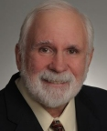
The NAEPC
Education Foundation
Clark B. McCleary
Foundation President, 2013
Pettus C. Gibbons

Slide 22

Local Council
Web Site Program
Bruce Newburger
NAEPC Webmaster
Robert P. Goodman
Web Committee Chair
Chris Jakyma
Web Committee Vice Chair

Slide 23
New Features for 2013
National, Council sites reprogrammed!
  Significant re-investment in platform
  Better security and performance
  Ability to add new functions/features
  Storage of RSVP and Renewal data
  Admin User Manual now available
New feature:
  Estate Planning Services Directory (Level 3+ only)
App for Android/iPhone/iPad

Slide 24
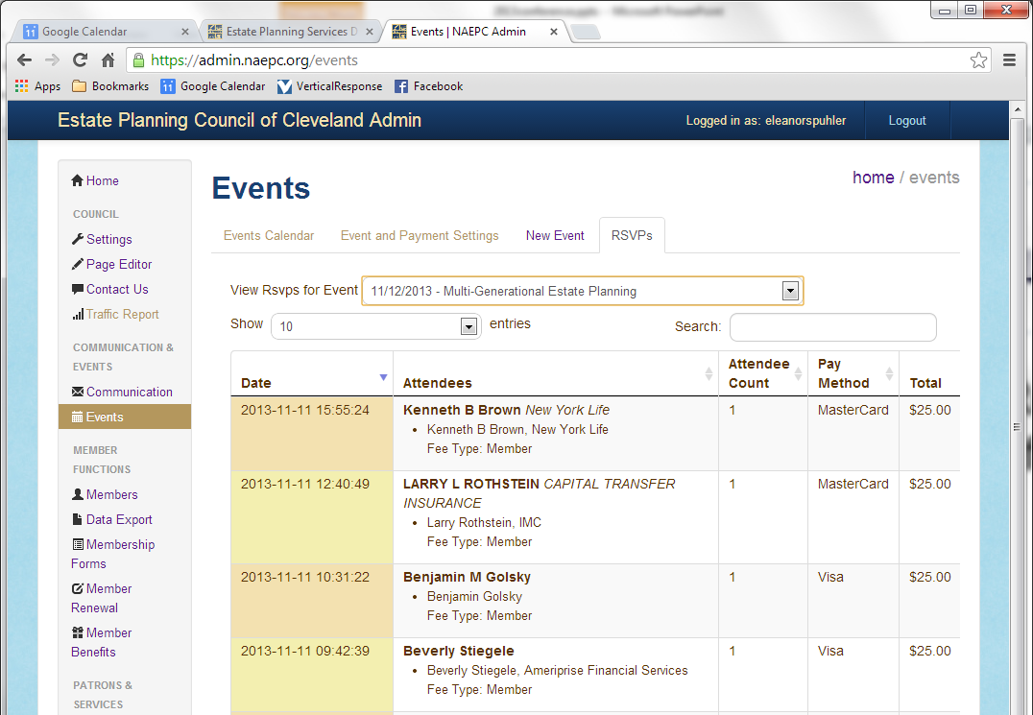
Tools to Manage Councils
Event RSVP and Member Renewal data is stored for future reference:

Slide 25
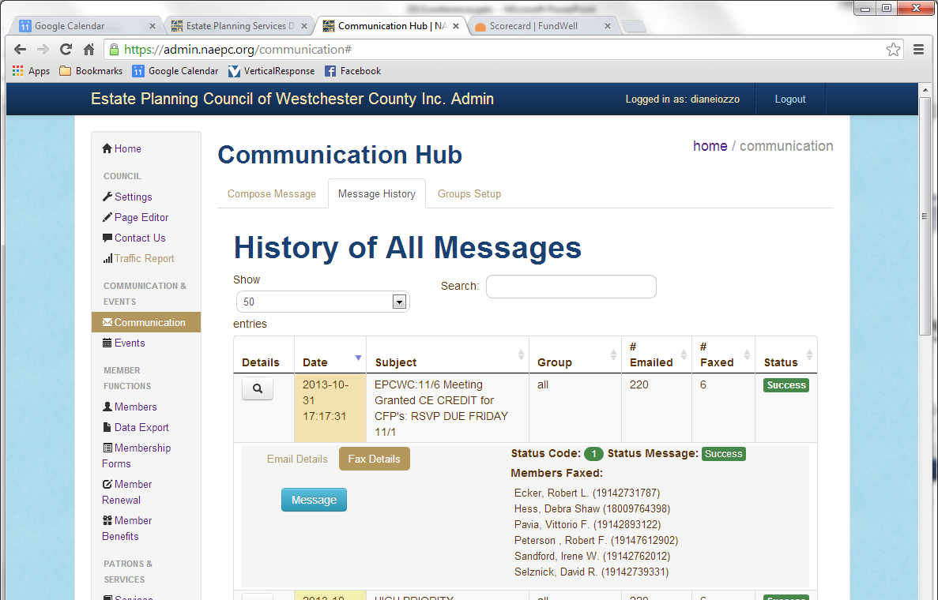
Tools to Manage Councils
Broadcast Communication shows what was sent to whom:

Slide 26
Estate Planning Services Directory
Public directory of service providers allows full member list to be private
Allows for service listings of non-members
Revenue opportunities:
  Main page banners
  Enhanced listings
  Logos and links
  Non-member listings
  Additional category listings
Examples: Chicago, Demo Council
For Level 3+ councils only

Slide 27

New App for Android/iPhone/iPad
Find EPCs
Find AEPs
Benefits
Journal
Events
Contest
Contact
4 Clients
Available now for Android in the Google Play Store and iOS version in the iTunes App.

Slide 28
Program Levels
Options for council administrators:
  Link to external site
  Level 1: Directory listing on NAEPC.org
  Level 2: Standard Site ($800/year)
  Level 3: Deluxe Site ($1,200/year)
  Level 4: w/Pay. Processing ($1,600/yr)
2013-14 Promotion: 50% off first-year fee for new site or upgrade costs.

Slide 29
Participating Councils
Of 242 Affiliated Councils

Slide 30
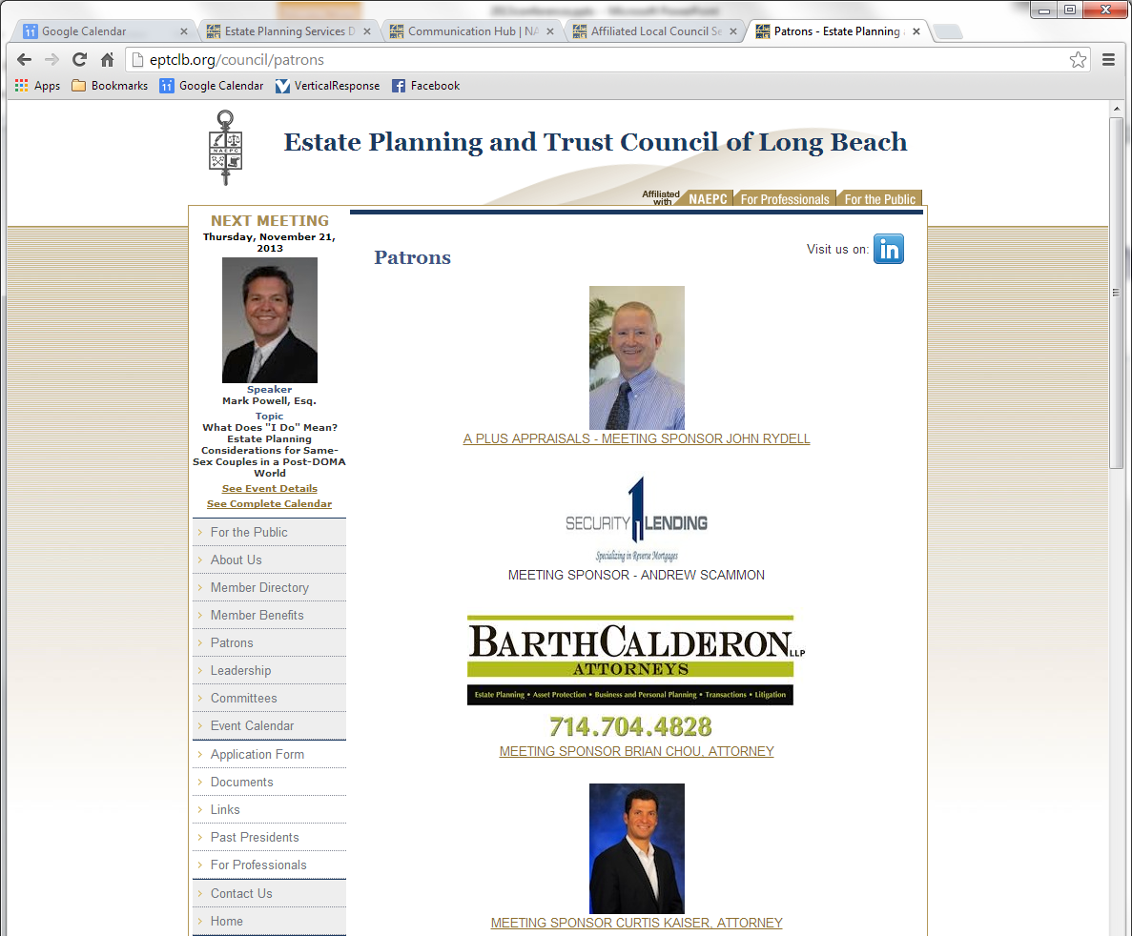
How to Generate Revenue
Many options for sponsorship placement:

Slide 31
Council Use of LinkedIn
LinkedIn groups already managed by national association:
  The NAEPC Education Foundation
  NAEPC Affiliated Local Council Leadership
  AEP®/Accredited Estate Planners®
  National Association of Estate Planners & Councils
NAEPC has documents to you help your council form and manage a LinkedIn group.

Slide 32

Web Site Support Contacts
First contact is NAEPC staff at:
admin@naepc.org
You may hear back from Bruce Newburger:
webmaster@naepc.org
Bruce available for appointments all day Wednesday and first half of Thursday

Slide 33
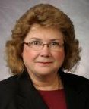
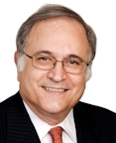
Accredited Estate Planner® Designation Committee
M. Eileen Dougherty
Committee Chair
William D. Kirchick
Committee Vice-Chair

Slide 34
2013 Highlights
Increased Growth & Acceptance
Continued Advancement of Council Nomination Program
Ongoing Review of Qualifying Coursework
Strategic Alliances
2014 Estate Planning Hall of Fame® Entrants
Continued Review of Nomination & Selection Procedures for the Estate Planning Hall of Fame®
3rd Annual Private Session at Annual Conference

Slide 35
Council Nominated Program
Council Participation by Size
100 members or less, 1 from each discipline
+ 1 in any discipline
101 members or more, 2 from each discipline
+ 2 from any discipline
Council Resolution in Lieu of References
15 Years of Experience Required to Qualify

Slide 36
We thank those 21 councils that have utilized the council nominated program in 2013…
Boulder County Estate Planning Council
Bristol County Estate Planning Council
Charlotte Estate Planning Council
Estate Planning Council of Chattanooga
Chester County Estate Planning Council
Estate Planning Council of Cleveland
Denver Estate Planning Council
Eastern Illinois Estate Planning Council
Estate Planning Council of Greater Miami
Hampton Roads Estate Planning Council
Los Angeles Estate Planning Council
Estate Planning Council of Marion County
Martin County Estate Planning Council
Financial & Estate Planning Council of Metro Detroit, Inc.
Mid-Florida Estate Planning Council
Nassau County Estate Planning Council
New Orleans Estate Planning Council
Palm Beach County Estate Planning Council
Quad City Estate Planning Council
Sioux Falls Estate Planning Council
Estate Planning Council of St. Louis

Slide 37
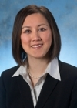
Estate Planning Council of Cleveland Initiative
Christine A. Myers
Council Board Member

Slide 38
Estate Planning Hall of Fame®
2013 Inductees
Frank S. Berall, Attorney
Gail E. Cohen, Trust Officer
Albert E. Gibbons, Insurance & Financial Planning
Tim Kochis, Insurance & Financial Planning
Lawton M. Nease, Insurance & Financial Planning
Duncan E. Osborne, Attorney
Martin Shenkman, Attorney
E. Randolph Whitelaw, Trust Officer

Slide 39
Estate Planning Hall of Fame®
2014 Inductees
Alexander A. Bove, Jr., Attorney
Arthur J. Dixon, Accounting (posthumous)
Bernard A. Krooks, Attorney
Paul S. Lee, Insurance & Financial Planning
Lee J. Slavutin, Insurance & Financial Planning
John A. Wallace, Attorney
Randy L. Zipse, Insurance & Financial Planning

Slide 40
2014 Goals
Education
Networking
Increased Recognition
Practice Tools & Growth
Marketing

Slide 41
5 decades of excellence
50th Annual Conference Celebratory Panel

Slide 42
Morning Break •
Castellana Commons
General Session Resumes
at 10:55 am

Slide 43
NAEPC &
The NAEPC Education Foundation
50th Annual Conference
COUNCIL LEADERSHIP DAY

Slide 44
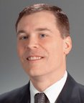
Annual Conference Committee
Jordon N. Rosen
Committee Chair
S. Mark Alton
Committee Vice-Chair

Slide 45


Slide 46






50th Annual Conference Sponsors
PLATINUM SPONSOR
GOLD SPONSORS

Slide 47
50th Annual Conference Sponsors
American Endowment Foundation (AEF)
Ashar Group - Secondary Market Specialists
BNY Mellon Wealth Management
Crozier Fine Arts, Inc.
Heritage Auctions
Mass Mutual Financial Group
Nationwide Valuations
Northwestern Mutual
South Dakota Trust Company LLC
U.S. Trust, Bank of America Private Wealth Management
Whittier Trust
DON’T FORGET TO VISIT THE EXHIBIT HALL TO MEET WITH ALL OF THE 50TH ANNUAL CONFERENCE SPONSORS & EXHBITORS
SILVER
SPONSORS

Slide 48
50th Annual Conference Sponsors
Thursday, November 21, 2013 • 7:00 am
Option 1:
“The Secondary Market for Life Insurance, the Market Today”
Offered by: James Camper of Coventry
Option 2:
“Searching for Missing Heirs of Beneficiaries: What You Need to Know
about the Heir-Tracing Industry to Protect the Heir’s Interests and Your
Fiduciary Duty”
Offered by: Suzanne Simpson of International Genealogical Search Inc.
Friday, November 22, 2013 • 7:00 am
“How to Give Your Clients a Seamless Solution for Finding and Managing
an Employee”
Offered by: Tom Breedlove of CARE.COM
BONUS SESSIONS

Slide 49
With Thanks…
Entire Conference Committee
Richard A. Oshins
MJM Administrative Team
Accredited Estate Planner®
Committee for Their Special
Session Thursday Evening

Slide 50
New This Year
Breakout Sessions on
Thursday & Friday Afternoon
Extended Administrator’s
Track
Estate Planning Law Specialist
Review Course & Exam

Slide 51

SAVE THE DATE
51st Annual Conference
November 5th – 7th
2014

Slide 52
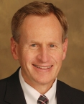
Council Relations Committee
Paul S. Viren
Committee Chair

Slide 53
Our Purpose
To communicate and work with our affiliated local councils to help them grow and be successful by:
Assisting affiliated local councils in understanding the benefits, programs, and services offered by the NAEPC
Research and contact unaffiliated councils and introduce them to the current benefits associated with joining NAEPC

Slide 54
Facts & Figures
Nearly 250 Affiliated Local Councils and their 28,000 Members
85 Prospect Councils throughout the United States
21 Active and Engaged Committee Members
9 New Councils in 2013
Anne Arundel County Estate Planning Council
Coeur d’ Alene Estate Planning Council
Columbus, Georgia Estate Planning Council
Estate Planning Council of Rhode Island
Fairbanks Estate Planning Council
Kitsap County Estate Planning Council
Sagemark Consulting Estate Planning Council, a Virtual Council
Santa Clara County Estate Planning Council
Tuscaloosa Estate Planning Council

Slide 55
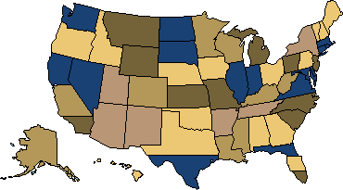
Our Territories

Slide 56
Standard Benefits of Membership
Online listing as an affiliated local council with contact information on www.NAEPC.org
Regular communication from NAEPC just for your leadership through the NAEPC Minute, a monthly administrative update
Member retention through use of the Council Nominated AEP® Program
Growing list of valuable benefits available to your membership with NO ADDITIONAL WORK by your board
    Trusts & Estates $129 subscription rate
    Ruby Receptionists
    NAEPC Journal of Estate & Tax Planning

Slide 57
Standard Benefits of Membership
Invitation to participate in Council Leadership Day at each annual conference
Referral lists and sample documents, best practice information, and other councils
Ability to engage one free national speaker each year through the no-charge speaker program – 9 available!
Access to online Speaker’s Bureau containing nearly 40 speakers with varying areas of expertise

Slide 58
Optional Benefits of Membership
(Council Must Opt-In)
Enroll members in the Every Council Campaign to receive the national newsletter, NAEPC News
Low-cost, continuously enhanced website platforms created and developed just for the estate planning council
Unsure of which services your council is taking advantage of? Reference the council services packet obtained at registration for details (the packet has a yellow cover page.)

Slide 59
Optional Benefits of Membership
(Council Must Opt-In)
Steve Leimberg’s LISI Service
Per Member Cost Per Year:
Enroll in Jan., Feb., March, or April - $20 / member / year
Enroll in May, June, July, or August - $16 / member / year
Enroll in Sept., Oct., Nov., or Dec.* - $26 / member / year
(*service carries through the following calendar year)
Example: 50 member council enrolling in January
50 members X $20 = $1,000
All members of the council must be enrolled.

Slide 60
Discounts Just for the Council
Sterling Cut Glass (discounted crystal award pieces)
PS Awards (discounted plaques & trophies)
DocuBank “lunch is on us” program
Discounted Merchant Accounts for Councils Creating a Level 4 Website
Konica / Minolta Office Equipment

Slide 61
Referral Lists
NAEPC & the AEP® Designation, What We Are All About?
Building Relationships with Nearby Councils
Creating a LinkedIn Group - Considerations & Decisions
Best Practices for Recognizing New & Existing AEP® Designees
What Type of Insurance Does our Council Need?

Slide 62
PowerPoint Presentations
PowerPoint Presentation for Members of Newly Affiliated Councils
Programs & Services Presentation (Long)
Sample pre-meeting PowerPoint presentation

Slide 63
Documents
Sample Sponsor Kit
Sample Speaker Confirmation Notice
Model Non-Profit Corporation Bylaws
Model Board Nomination Form
Model Non-Profit Corporation Articles of Incorporation 501c6
Model Non-Profit Corporation Articles of Incorporation 501c3
Sample Whistleblower Policy - Tracking Report
Sample Whistleblower Policy
Sample Conflict of Interest
Sample Annual Board Recommitment Form

Slide 64
Robert G. Alexander
Webinar Series
Created in 2013 to educate individuals through our network of affiliated local councils.
3rd Wednesday of each month at 3:00 pm ET
Educational content
Provides one hour of AEP® CE
$40 AEP® Designee
$60 Member of a council
$100 non-member
$250 council meeting or group gathering
Cost to Participate

Slide 65
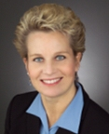
Member Benefits Committee
Julie A. Buschman
Committee Chair

Slide 66
Our Purpose
The NAEPC Member Benefits Committee investigates and approves “Value Partners,” organizations that have submitted an application and have agreed to provide a product or service at a reduced fee for members of the affiliated local council.
Value Partners are provided as a resource to your members with no additional work on behalf of your board of directors!

Slide 67
Value Partners Added in 2013
Fiserv Investment Services
Legal Binders Now (LBN)
Loring and Rounds: A Trustees Handbook
My Personal DataSafe LLC
NationalUnderwriter.com
Wolters Kluwer Law & Business

Slide 68
Value Partners Exhibiting in Las Vegas
Crummey Service.com
International Genealogical Search
DocuBank
My Personal DataSafe
Lawgic

Slide 69
For a list of all value partners, check out the “member benefits brochure” on your flash drive. This brochure is available for your council to use at its meetings.
Contact our office for a copy.

Slide 70
Online Speaker’s Bureau
New Speakers in 2013
Dorie Fain
& Wealth • Baltimore, MD
Eric A. Manterfield, Atty (retired)
Krieg DeVault, LLP • Indianapolis, IN
Ken Nopar
Nopar Consulting • Arlington Heights, IL

Slide 71
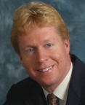
Publications Committee
Charles V. Douglas
Committee Chair

Slide 72
NAEPC Journal of
Estate & Tax Planning
Mission
To offer a non-static resource where practitioners can easily access the best-in-class planning content across the various disciplines within the estate planning industry.
The Journal seeks to synergistically create and maintain a unique, one-stop, complementary, online estate planning resource.

Slide 73
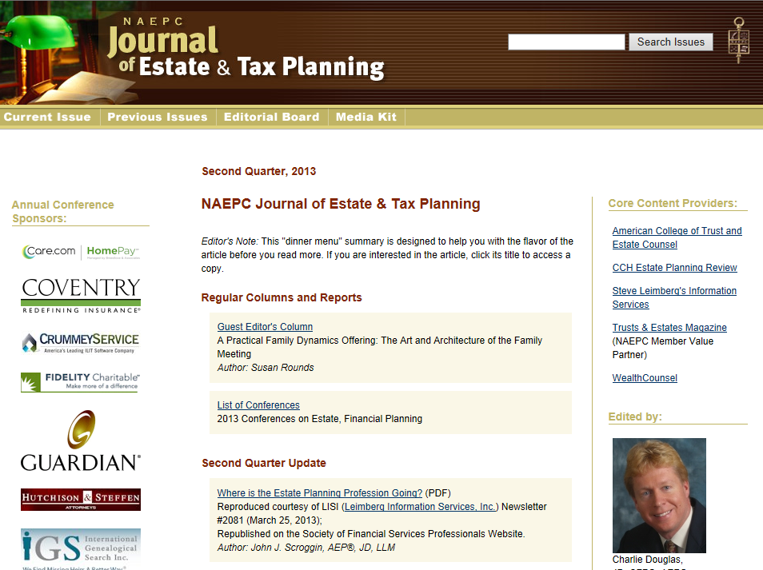
www.NAEPCJournal.org

Slide 74
NAEPC Journal of
Estate & Tax Planning
Facts
Complimentary
Published 4 times per year
Entirely internet-based
Notices offered within NAEPC News and directly to AEP® Designees
Almost solely PDF-based

Slide 75
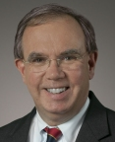
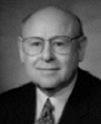
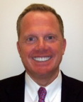
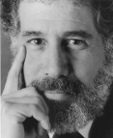
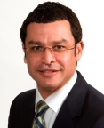
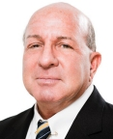
NAEPC Journal of Estate & Tax Planning Editorial Board
Charles D. Fox, IV, A.B., M.A., JD, AEP® (Distinguished)
Sidney Kess, CPA, JD, LL.M., AEP® (Distinguished)
Al W. King, III, JD, LL.M., AEP® (Distinguished)
Stephan R. Leimberg, JD, AEP® (Distinguished)
Jonathan A. Mintz, JD
Rich Santos
Charles V. Douglas, JD, CFP®, AEP®, Editor
Notes:
75

Slide 76
NAEPC Journal of Estate & Tax Planning Usage
 | 2009 Annual | 2010 Annual | 2011 Annual | 2012 Annual | 2013 To Date
Visits | 25,575 | 29,723 | 60,381 | 55,562 | 43,475
The Way We Research Issues and Seek Information Has Changed
Notes:
76

Slide 77
Core Content Providers
Leimberg Information Services Inc.
Trusts & Estates Magazine
Commerce Clearing House’s Estate Planning Review
WealthCounsel
American College of Trust & Estate Counsel
AICPA
WealthManagement.com
Society of Financial Services Professionals

Slide 78
How Can My Council Help?
READ THE JOURNAL!
SHARE THE JOURNAL WITH COUNCIL MEMBERS!
LINK TO THE JOURNAL!

Slide 79
Upcoming Activities
12:00 pm – 1:00 pm
Lunch with Exhibitors – Brera Ballroom
1:00 pm – 5:00 pm
Council by Size Breakout Sessions
Small Councils – Condesa 8, 2nd Floor
Medium Councils – Condesa 2, 2nd Floor
Large Councils – Condesa 5 & 6, 2nd Floor
5:00 pm – 7:00 pm
Welcome Reception with Exhibitors, Brera Ballroom

